Slide 1


.NET Track
Employee Travel Booking Project
Presented by Vidya Mane- 220359

Slide 2
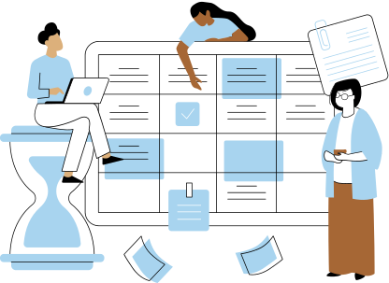
/02
Contents
This presentation outlines the Employee Travel Booking Project for the .NET Track, including project objective, introduction, workflow, and prototype development, features, components used, Project screen, Conclusion.

Slide 3

/03
Problem Statement
The project aims to address the need for an Employee Travel Booking system in the corporate world, streamlining the travel request processes.

Slide 4
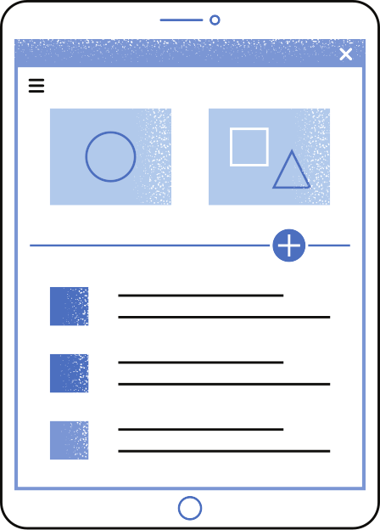

/04
Objective
To develop an Employee Travel Booking Application that enables employees to request travel tickets and managers and to approve business travel requests efficiently.

Slide 5

/05
Abstract
The Employee Travel Booking Console Application empowers employees to efficiently request and reserve business travel tickets, meeting the travel needs of the modern corporate landscape. With ever-increasing requirements for both domestic and international travel in the business world, this innovative console application, the 'Employee Travel Booking Console Application,' simplifies the process of submitting travel requests.
This console-based system offers automation for raising and managing travel requests. Employees can effortlessly initiate a travel request, which is then subject to approval or rejection by a manager through a text-based interface. Upon manager approval, a travel agent takes over, either confirming the travel booking or marking it as 'Bookings not available,' ensuring a streamlined and efficient travel management process within the console environment.

Slide 6
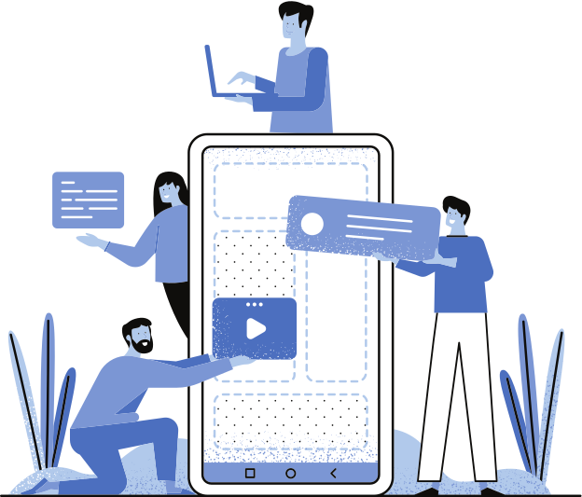
/06
Introduction
In today's fast-paced corporate world, where travel is a common necessity, our Employee Travel Booking Console Application offers a unified solution for employees, managers, and travel agents. This versatile tool simplifies travel requests, enhances data security, and provides multiple views for efficient decision-making. Join us in exploring this all-in-one travel management solution that caters to the diverse needs of your organization.

Slide 7
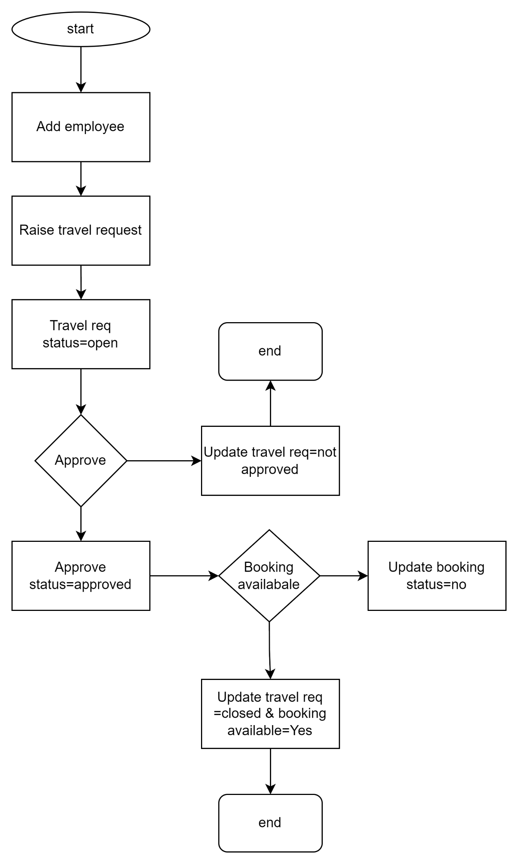
/07
Flow Chart

Slide 8
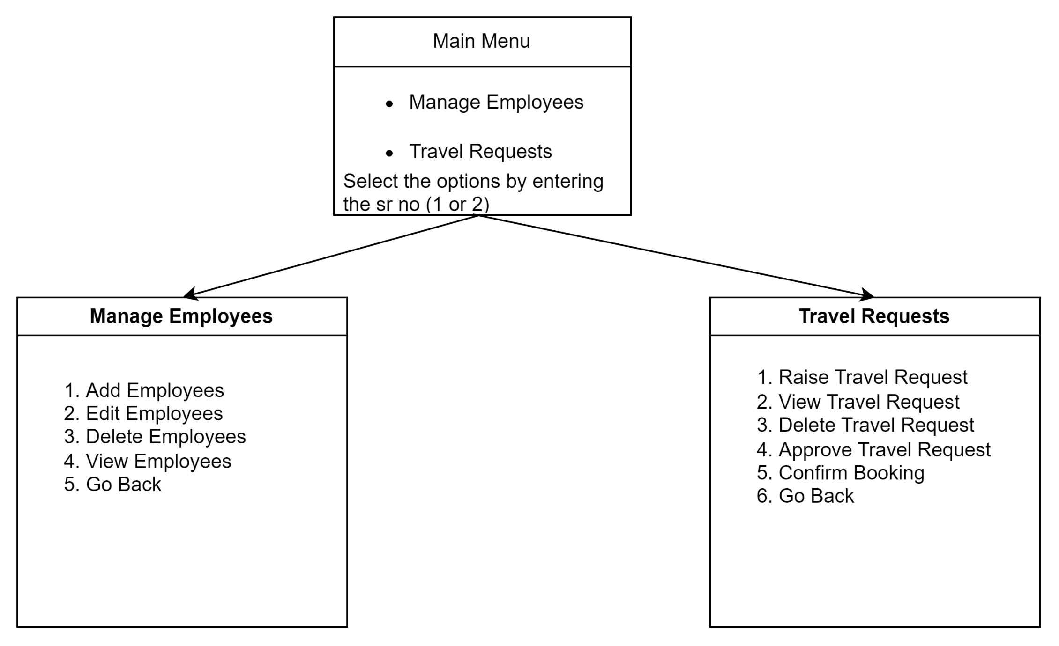
/08
Console Screens

Slide 9
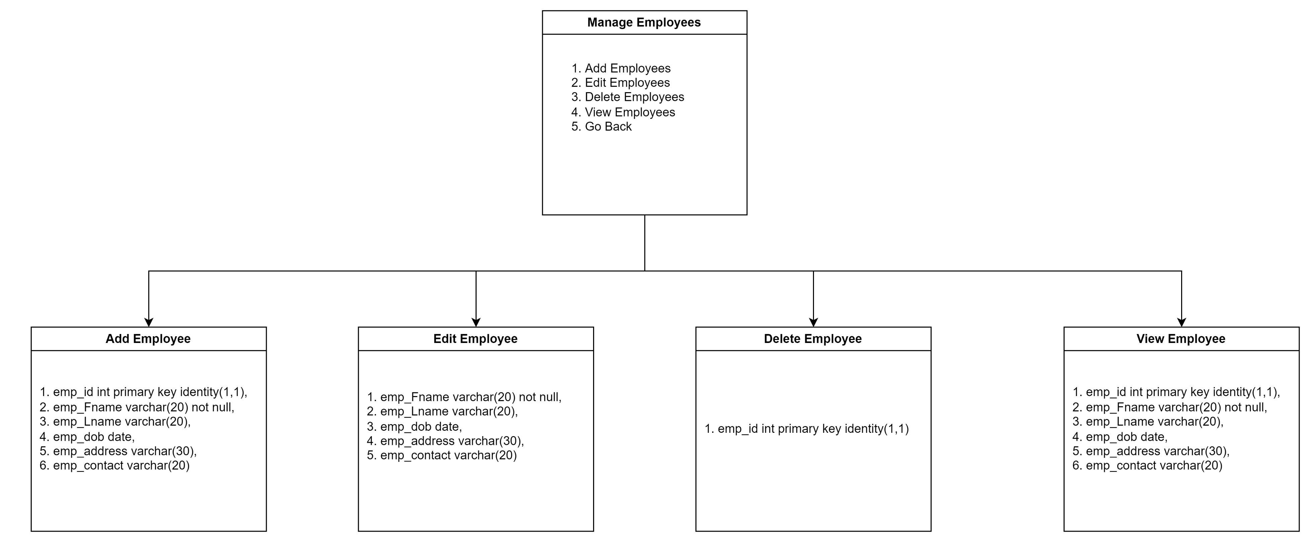
Console Screens
/09

Slide 10
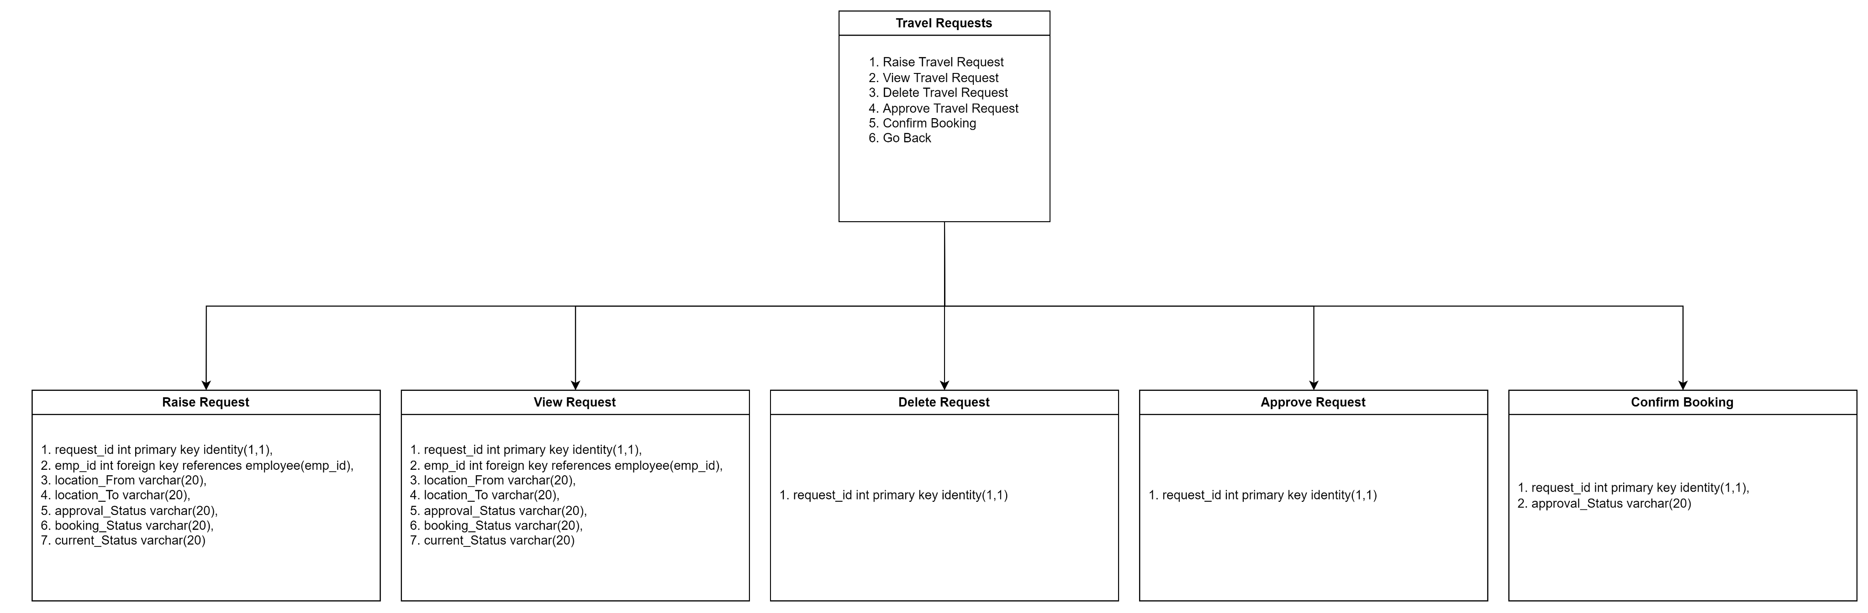
Console Screens
/10

Slide 11
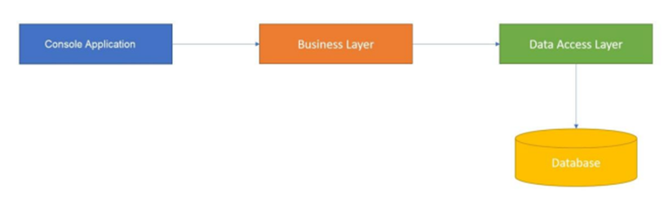
Project Flow
/11

Slide 12


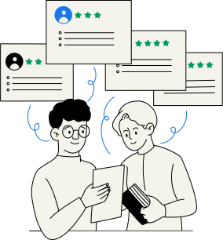
/12
Prototype Development
Add/Edit/Delete/View Employee Screen
Raise/Edit/Delete/View/Approve Status/Confirm Booking/Current Status Travel Request Screen
Main Menu/Manage Employee Menu/Manage Travel Request Menu Screen

Slide 13

/13
Features
Layered Architecture for Data Security: The Employee Travel Booking Console Application is built on a robust layered architecture, comprising Data Access Layer and Business Layer. This architectural design enhances data security and separation of concerns.
Comprehensive Error Handling: To ensure smooth user interactions, the application features extensive error handling. It effectively handles scenarios where user input conflicts with expected data types, providing a seamless and user-friendly experience.
Data Integration via Table Joins: The application seamlessly integrates data by performing table joins between the 'Employee' table and the 'Travel Request' table. This powerful feature facilitates comprehensive reporting and decision-making by combining employee information with their respective travel requests.
Multi-view Functionality: The application offers various views for different aspects of travel requests, including:
Approved Requests View: Displays successfully approved travel requests, providing visibility into confirmed travel plans.
Open Requests View: Allows users to see pending travel requests that are yet to be processed by managers or travel agents.
Confirmed Requests View: Shows requests with travel bookings confirmed, ensuring clarity on upcoming trips.
Pending Requests View: Provides insight into requests awaiting approval or rejection, streamlining the decision-making process.

Slide 14
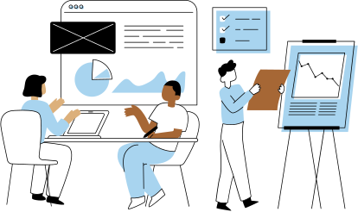
/14
Components and Design tools used
1. Development Components:
.NET Framework: Used as the core development framework.
C# Programming Language: Primary language for coding.
Visual Studio 2022: The Integrated Development Environment (IDE) for building, debugging, and deploying the project.
Class Library (.NET Framework): Used to create class objects and relationships.
Console Application (.NET Framework): The application's user interface.
2. Design Tools:
Draw.io: Utilized for creating Entity Relationship Diagrams (ERD) to design the database structure.
3. Development Tools:
Git for Version Control: Ensuring code versioning and collaboration.

Slide 15
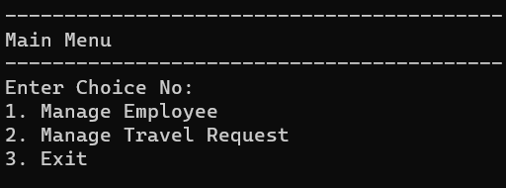
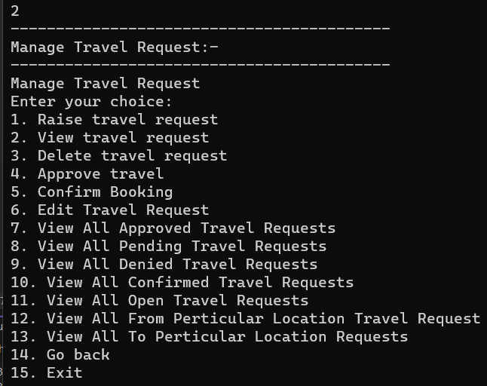
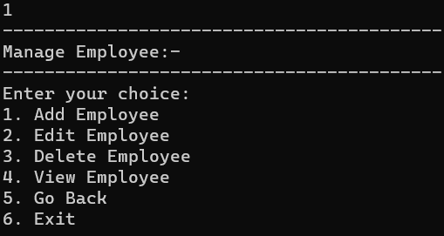
Project Screen
/15

Slide 16

/16
Conclusion
In closing, the Employee Travel Booking Console Application is your one-stop solution for efficient travel management. It simplifies the travel request process, enhances security, and supports decision-making. With a user-friendly interface, it caters to employees, managers, and travel agents, making it the perfect tool for modern businesses.
GitHub Link:https://github.com/vidyam1631/Employee-Travel-Booking-Website

Slide 17


/17
Thank You!!

